Slide 1
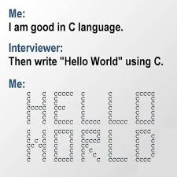
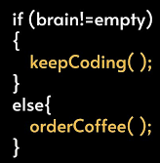

UPES-CSA
WELCOMES YOU !
C-WORKSHOP

Slide 2
Computer System
A Computer system is an electronic machine that takes raw data as input from the input devices (mouse, keyboard, joystick etc.), processes data with processing unit (ALU, CU & Memory Units) and gives output with the help of Output units(Monitor, Printer etc) and also saves output for the future use.
PROCESSING
INPUT
OUTPUT

Slide 3
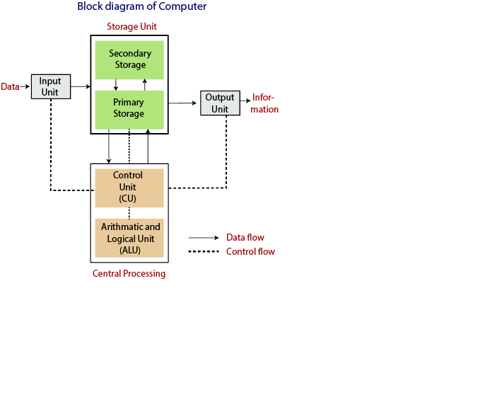
Block Diagram of Computer System

Slide 4
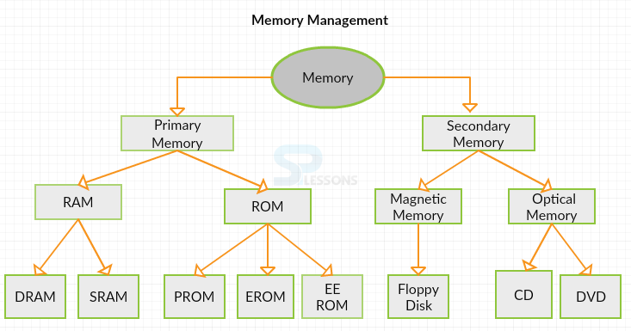
Types of Memory Unit
Notes:
RAM :- Random Access Memory
ROM :- Read Only Memory
DRAM :- Dynamic random-access memory- type of random access semiconductor memory that stores each bit of data in a memory cell consisting of a tiny capacitor and a transistor, both typically based on metal-oxide-semiconductor (MOS) technology.
SRAM :- Static random-access memory- is a type of random-access memory (RAM) that uses latching circuitry (flip-flop) to store each bit. SRAM is volatile memory; data is lost when power is removed.
PROM:- A programmable read-only memory - is a form of digital memory where the setting of each bit is locked by a fuse or antifuse.
ERPM / EPROM :- An EPROM (rarely EROM), or erasable programmable read only memory, is a type of memory chip that retains its data when its power supply is switched off. It is non-volatile.
EEROM :- Electrically Erasable Programmable Read-Only Memory -is a type of non-volatile memory used in computers and other electronic devices to store small amounts of data. It can be erased and reprogrammed through the application of electrical charge.

Slide 5
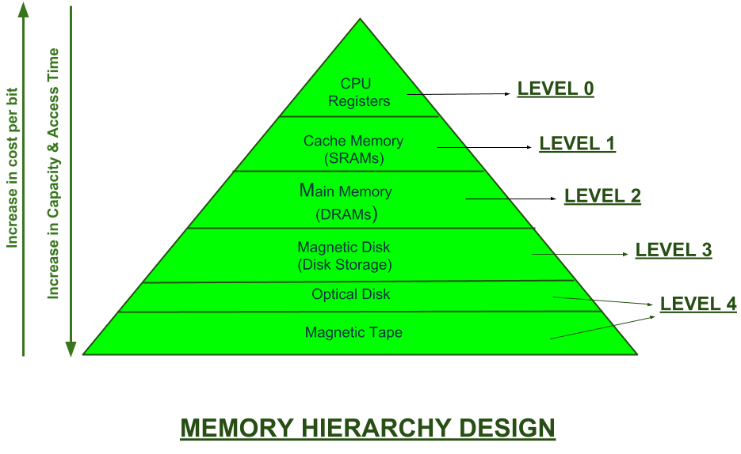
Memory Hierarchy
Computer Memory can be divided into 4 categories:
CPU register
Cache memory
Primary / Main memory
Secondary Memory / Mass Storage

Slide 6
Primary & Secondary Memory
Sr.No. | Primary memory | Secondary memory
1. | Primary memory is temporary. | Secondary memory is permanent.
2. | Primary memory is directly accessible by Processor/CPU. | Secondary memory is not directly accessible by the CPU.
3. | Nature of Parts of Primary memory varies, RAM- volatile in nature. ROM- Non-volatile. | It’s always Non-volatile in nature.
4. | Primary memory devices are more expensive than secondary storage devices. | Secondary memory devices are less expensive when compared to primary memory devices.
5. | The memory devices used for primary memory are semiconductor memories. | The secondary memory devices are magnetic and optical memories.
6. | Primary memory is also known as Main memory or Internal memory. | Secondary memory is also known as External memory or Auxiliary memory.
7. | Examples: RAM, ROM, Cache memory, PROM, EPROM, Registers, etc. | Examples: Hard Disk, Floppy Disk, Magnetic Tapes, etc.

Slide 7
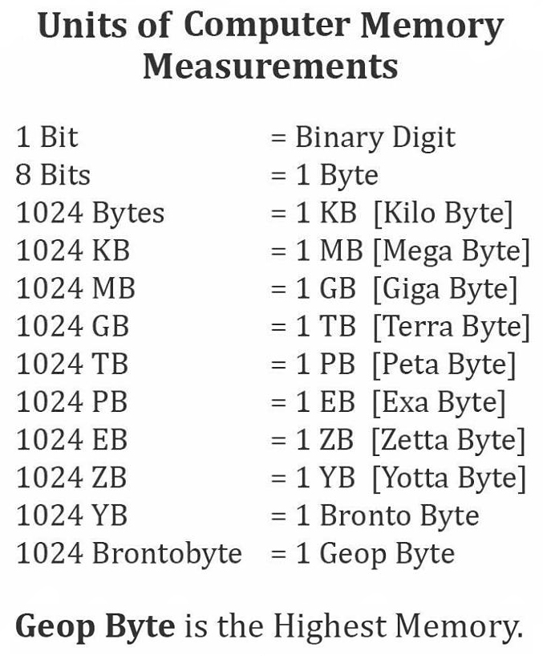
Computer - Memory Units
Memory unit is the amount of data that can be stored in the storage unit. This storage capacity is expressed in terms of Bytes.
S.No. | Unit & Description
1 | Bit (Binary Digit) A binary digit is logical 0 and 1 representing a passive or an active state of a component in an electric circuit.
2 | Nibble A group of 4 bits is called nibble.
3 | Byte A group of 8 bits is called byte. A byte is the smallest unit, which can represent a data item or a character.
4 | Word A computer word, like a byte, is a group of fixed number of bits processed as a unit, which varies from computer to computer but is fixed for each computer. The length of a computer word is called word-size or word length. It may be as small as 8 bits or may be as long as 96 bits. A computer stores the information in the form of computer words.

Slide 8
CPU OPERATION
There are four steps that nearly all CPUs use in their operation: fetch, decode, execute, and write back.

Slide 9
Debugging
To debug a program or hardware device is to start with a problem, isolate the source of the problem, and then fix it.
Process of identifying, isolating and correcting the errors
Two Categories –
Syntax errors -- Errors in spelling and grammar.
You can use the compiler or interpreter to uncover syntax errors.
You must have a good working knowledge of error messages to discover the cause of the error.
Example: C line -> printf(“Hello!”)
 Logical errors -- Errors that indicate the logic used when coding the program failed to solve the problem.
You do not get error messages with logic errors.
Your only clue to the existence of logic errors is the production of wrong solutions.

Slide 10
Differences between compiler and interpreter
S. No | Compiler | Interpreter
1 | Performs the translation of a program as a whole. | Performs translation statement by statement .
2 | Execution is faster. | Execution is slower.
3 | Requires more memory as linking is needed for the generated intermediate object code. | Memory usage is efficient as no intermediate object code is generated.
4 | Debugging is hard as the error messages are generated after scanning the entire program only. | It stops translation when the first error is met. Hence, debugging is easy.
5 | Programming languages like C, C++ uses compilers. | Programming languages like Python, BASIC, and Ruby uses interpreters.

Slide 11
Object file and Executable file
An object file is a file containing object code, meaning relocatable format machine code that is usually not directly executable.
Object file has .o extension e.g. hello.o
Object files are produced by an assembler, compiler, or other language translator, and used as input to the linker, which in turn typically generates an executable file.
An executable file is formed by linking the Object files and has .exe extension.
Object file contains low level instructions which can be understood by the CPU. That is why it is also called machine code.

Slide 12
Difference between Object file and Executable file :
Both are binary files but the differences between those are:-
we can execute an executable file while we cannot execute an object file.
An object file is a file where compiler has not yet linked to the libraries, so you get an object file just before linking to the libraries, so still some of the symbols or function definitions are not yet resolved which are actually present in the libraries, and that's why we cannot execute it.

Slide 13
BASIC C Program
Pre-processor Directive
Header File
#include<stdio.h>
void main()
{
printf(“Welcome to UPES CSA C- Workshop”);
}
Main function
No return Value
End of a Statement
To print on the output screen

Slide 14
Variables in C
A variable is nothing but a name given to a storage area that our programs can manipulate. Each variable in C has a specific type, which determines the size and layout of the variable's memory; the range of values that can be stored within that memory; and the set of operations that can be applied to the variable.

Slide 15
Data Types in C
Primary data types:
These are fundamental data types in C namely integer(int), floating point(float), character(char) and void.
Derived data types:
Derived data types are nothing but primary datatypes but a little twisted or grouped together like array, stucture, union and pointer.

Slide 16
Commonly used Data Types in C
Data Type | Size (In Bytes)
Char | 1
Int | 2 or 4
Unsigned Int | 2 or 4
Short (Int) | 2
Unsigned Short | 2
Float | 4 or 8
Double | 8
Long Double | 10

Slide 17
Difference b/w variable declaration and definition
Variable declaration refers to the part where a variable is first declared or introduced before its first use.
For ex: int x;
Variable definition is the part where the variable is assigned a memory location and a value.
For ex: x = 10;
Most of the times, variable declaration and definition are done together.
For ex: int x = 10;

Slide 18
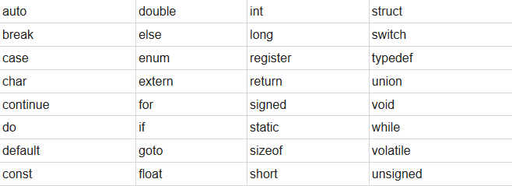
Keywords in C
Keywords are predefined, reserved words in C language and each of which is associated with specific features.
These words help us to use the functionality of C language. They have special meaning to the compilers.
There are total 32 keywords in C.

Slide 19
Operators in C
S.no | Types of Operators | Description
1 | Arithmetic_operators | These are used to perform mathematical calculations like addition, subtraction, multiplication, division and modulus
2 | Assignment operators | These are used to assign the values for the variables in C programs.
3 | Relational operators | These operators are used to compare the value of two variables.
4 | Logical operators | These operators are used to perform logical operations on the given two variables.
5 | Bit wise operators | These operators are used to perform bit operations on given two variables.
6 | Conditional (ternary) operators | Conditional operators return one value if condition is true and returns another value is condition is false.
7 | Increment / decrement operators | These operators are used to either increase or decrease the value of the variable by one.
8 | Special operators | &, *, sizeof( ) and ternary operators.

Slide 20
Arithmetic Operators in C:
S.no | Arithmetic Operators | Operation | Example
1 | + | Addition | A+B
2 | – | Subtraction | A-B
3 | * | multiplication | A*B
4 | / | Division | A/B
5 | % | Modulus | A%B

Slide 21
Example for C arithmetic operators:
#include <stdio.h>
void main()
{
int a=40,b=20, add,sub,mul,div,mod;
add = a+b;
sub = a-b;
mul = a*b;
div = a/b;
mod = a%b;
printf("Addition of a, b is : %d\n", add);
printf("Subtraction of a, b is : %d\n", sub);
printf("Multiplication of a, b is : %d\n", mul);
printf("Division of a, b is : %d\n", div);
printf("Modulus of a, b is : %d\n", mod);
}
OUTPUT
Addition of a, b is : 60 Subtraction of a, b is : 20 Multiplication of a, b is : 800 Division of a, b is : 2 Modulus of a, b is : 0

Slide 22
Assignment operators in C:
Operators |  | Example | Explanation
Simple assignment operator | = | sum = 10 | 10 is assigned to variable sum
Compound assignment operators | += | sum += 10 | This is same as sum = sum + 10
 | -= | sum -= 10 | This is same as sum = sum – 10
 | *= | sum *= 10 | This is same as sum = sum * 10
 | /= | sum /= 10 | This is same as sum = sum / 10
 | %= | sum %= 10 | This is same as sum = sum % 10
 | &= | sum&=10 | This is same as sum = sum & 10
 | ^= | sum ^= 10 | This is same as sum = sum ^ 10

Slide 23
Relational operators in C:
S.no | Operators | Example | Description
1 | > | x > y | x is greater than y
2 | < | x < y | x is less than y
3 | >= | x >= y | x is greater than or equal to y
4 | <= | x <= y | x is less than or equal to y
5 | == | x == y | x is equal to y
6 | != | x != y | x is not equal to y

Slide 24
Logical operators in C:
S.no | Operators | Name | Example | Description
1 | && | logical AND | (x>5)&&(y<5) | It returns true when both conditions are true
2 | || | logical OR | (x>=10)||(y>=10) | It returns true when at-least one of the condition is true
3 | ! | logical NOT | !((x>5)&&(y<5)) | It reverses the state of the operand “((x>5) && (y<5))” If “((x>5) && (y<5))” is true, logical NOT operator makes it false

Slide 25
Bit wise operators in C:
S.no | Operators | Description
1 | & | Bitwise AND
2 | | | Bitwise OR
3 | ~ | Bitwise NOT
4 | ^ | XOR
5 | << | Left shift
6 | >> | Right shift

Slide 26
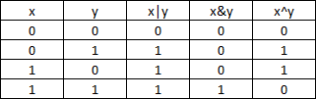
Truth Table for Bitwise OR, AND, and XOR

Slide 27
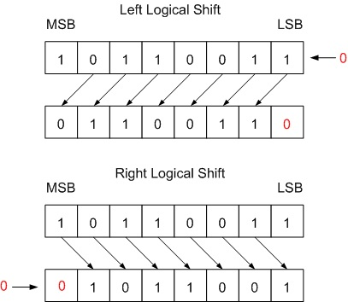
Left and Right Shift Example

Slide 28
Conditional or ternary operators in C:
Conditional operators return one value if condition is true and returns another value is condition is false.
This operator is also called as ternary operator.
Syntax : (Condition? true_value: false_value);
Example : (A > 100 ? 0 : 1);
In above example, if A is greater than 100, 0 is returned else 1 is returned. This is equal to if else conditional statements.

Slide 29
Example for conditional/ternary operators in C:
#include <stdio.h>
int main()
{
int x=1, y ;
y = ( x ==1 ? 2 : 0 ) ;
printf("x value is %d\n", x);
printf("y value is %d", y);
}
Output:
x value is 1
y value is 2

Slide 30
C – Increment/decrement Operators
Increment operators are used to increase the value of the variable by one and decrement operators are used to decrease the value of the variable by one in C programs.
Syntax:
Increment operator: ++var_name; (or) var_name++; Decrement operator: - -var_name; (or) var_name - -;
Example:
Increment operator : ++ i ; i ++ ; Decrement operator : – – i ; i – – ;

Slide 31
C – Increment/decrement Operators
S.no | Operator type | Operator | Description
1 | Pre increment | ++i | Value of i is incremented before assigning it to variable i.
2 | Post–increment | i++ | Value of i is incremented after assigning it to variable i.
3 | Pre decrement | - - i | Value of i is decremented before assigning it to variable i.
4 | Post_decrement | i - - | Value of i is decremented after assigning it to variable i.

Slide 32
Example
#include<stdio.h>
void main()
{
int i=1;
printf(“i=%d\n”,i++);
printf(“i=%d\n”,++i);
printf(“i=%d\n”,i++ + ++i);
}

Slide 33
Answer
#include<stdio.h>
void main()
{
int i=1;
printf(“i=%d\n”,i++);
printf(“i=%d\n”,++i);
printf(“i=%d\n”,i++ + ++i);
}
i=1
i=3
i=8

Slide 34
Example
#include<stdio.h>
void main()
{
int i=1, j;
j = i++ + ++i + i++;
//j = ++i + i++ + ++i;
printf(“i = %d \n j = %d”,i,j);
}

Slide 35
Answer
#include<stdio.h>
void main()
{
int i=1, j;
j = i++ + ++i + i++;
printf(“i = %d \n j = %d”,i,j);
}
i = 4
j = 7

Slide 36
Special Operators in C:
S.no | Operators | Description
1 | & | This is used to get the address of the variable. Example : &a will give address of a.
2 | * | This is used as pointer to a variable. Example : * a where, * is pointer to the variable a.
3 | Sizeof () | This gives the size of the variable. Example : sizeof (char) will give us 1.

Slide 37
Example program for sizeof() operator in C:
#include <stdio.h>
#include <limits.h>
int main()
{
int a;
char b;
float c;
double d;
printf("Storage size for int data type:%d \n",sizeof(a));
printf("Storage size for char data type:%d \n",sizeof(b));
printf("Storage size for float data type:%d \n",sizeof(c));
printf("Storage size for double data type:%d\n",sizeof(d));
return 0;
}

Slide 38
Example program for sizeof() operator in C:
Output:
Storage size for int data type:2
Storage size for char data type:1 Storage size for float data type:4 Storage size for double data type:8

